Slide 1
Control Tower & Multi Account

Slide 2
About Control Tower
“A consolidated abstraction of multiple AWS resources, the easiest way to set up and govern a secure, compliant, multi-account AWS environment based on best practices”

Slide 3
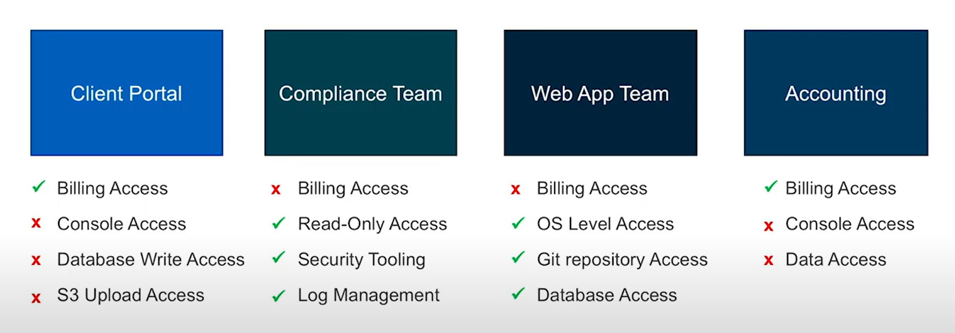
Multi Accounts

Slide 4
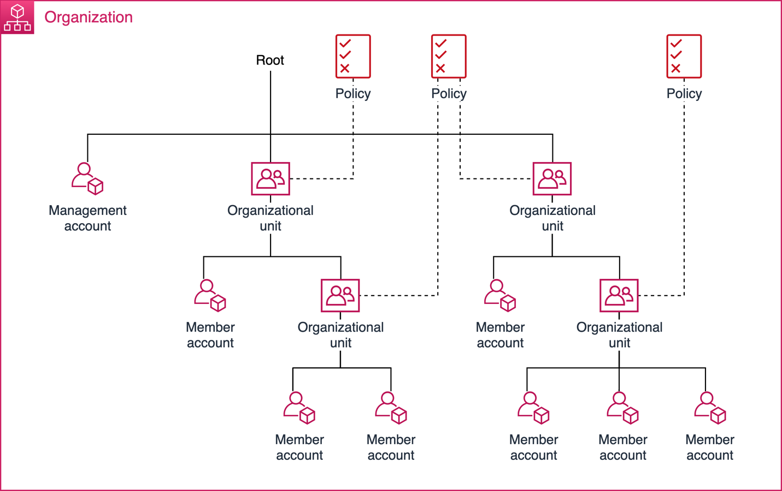
Organization

Slide 5
Benefits of Multi Accounts
Group workloads based on business purpose and ownership
Apply distinct security controls by environment
Constrain access to sensitive data
Promote innovation and agility
Limit scope of impact from adverse events
Support multiple IT operating models
Manage Costs
Distribute AWS Service Quotas and API request rate limits

Slide 6
Features
Landing Zone
Guardrail
Account Factory
Dashboard

Slide 7
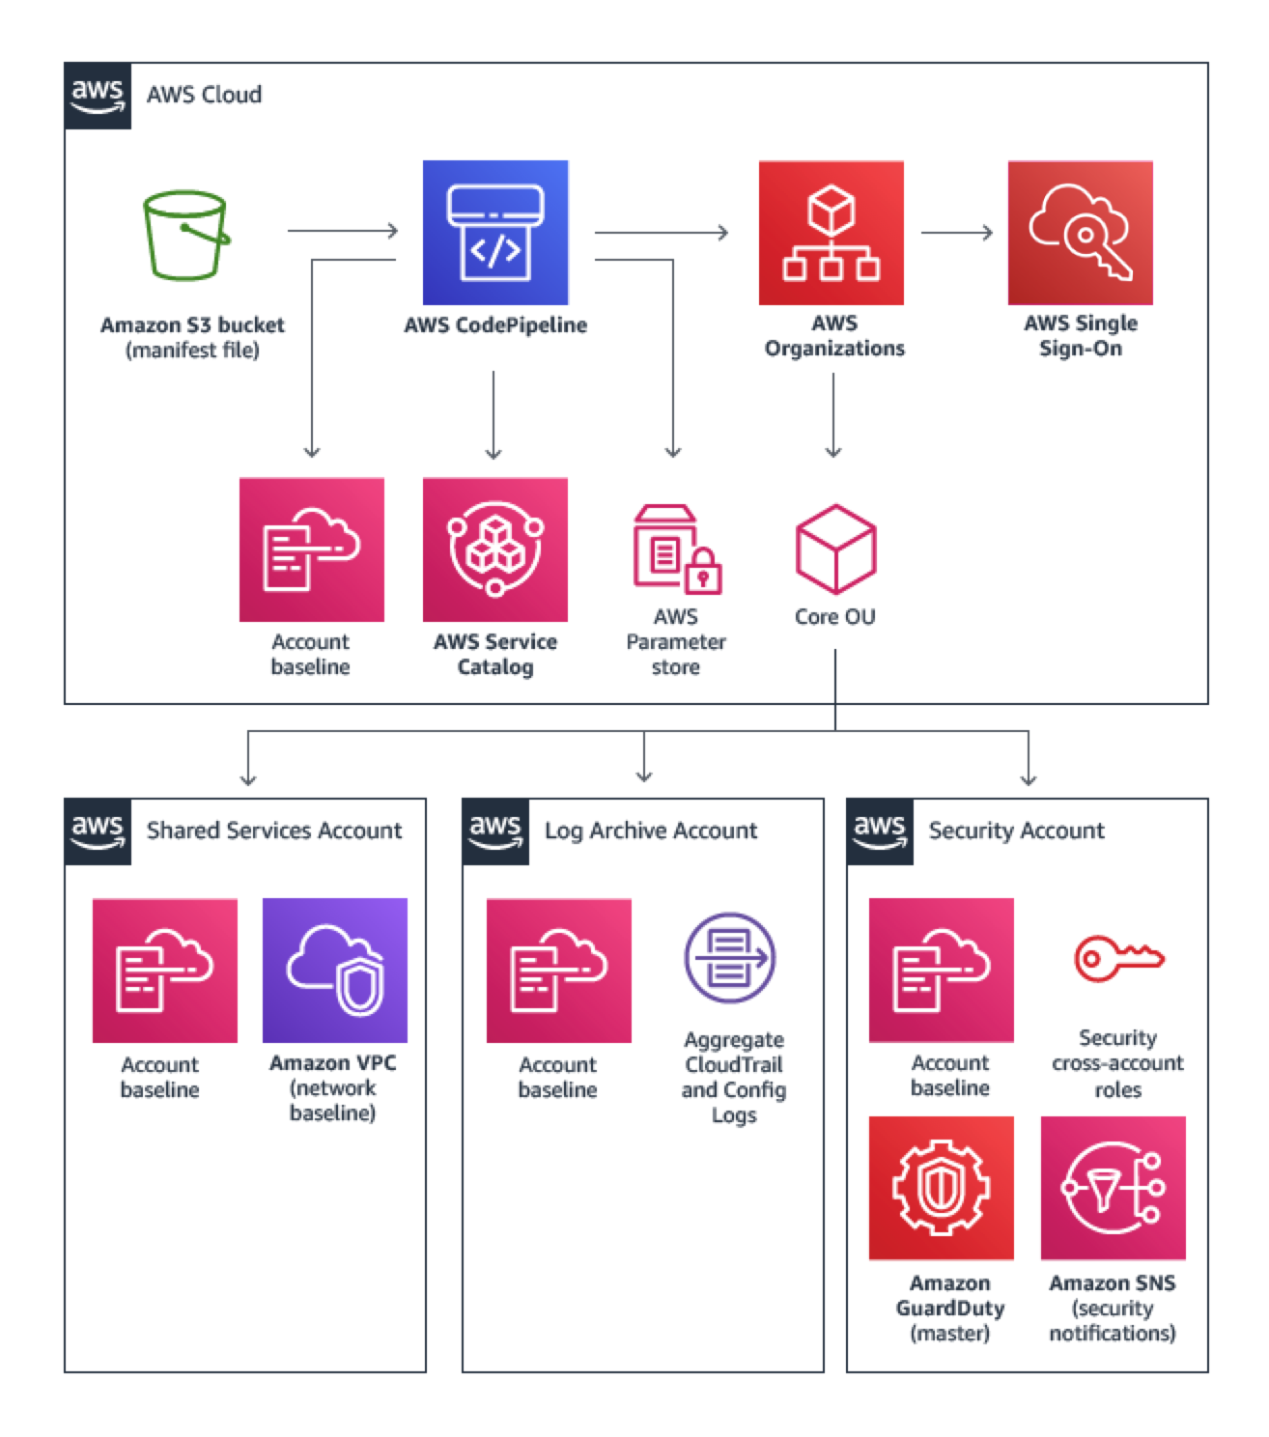
Landing Zone - 다중 계정 구조
AWS Service Catalog를 사용하여 배포할 수 있는 애드온 제품
+

Slide 8
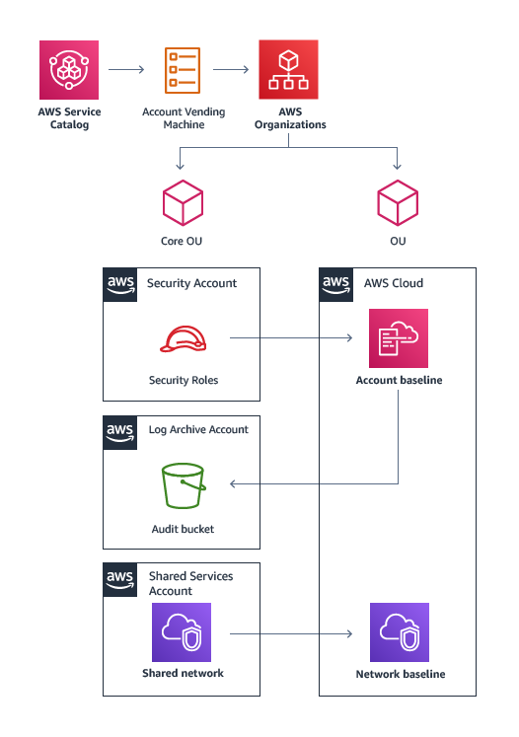
Landing Zone - Account Vending Machine

Slide 9
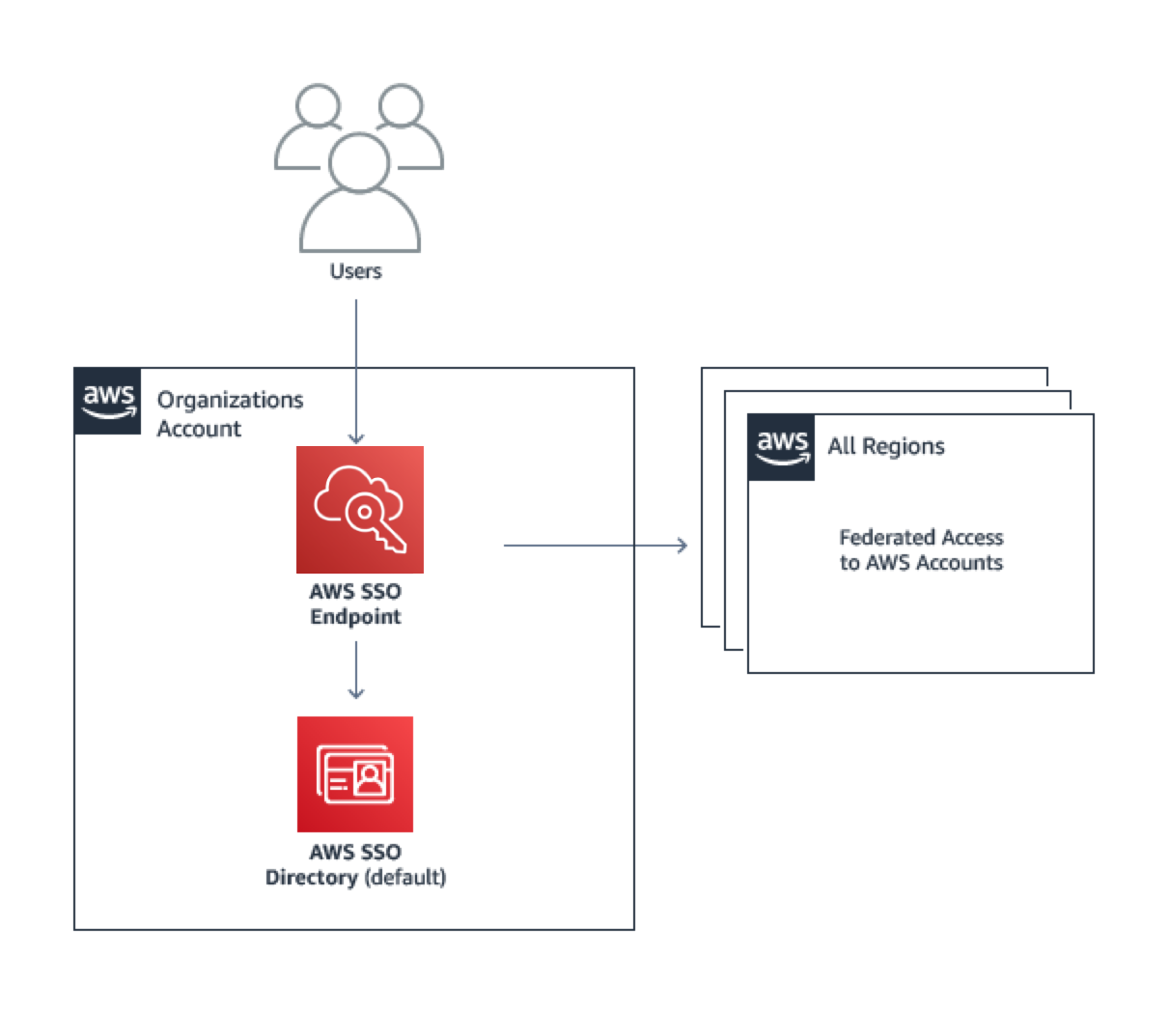
Landing Zone - User Access

Slide 10
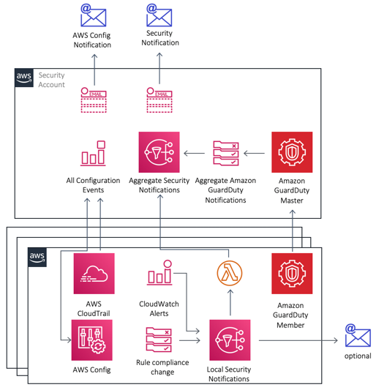
Landing Zone - 알림

Slide 11
Guardrail
Preventive & Detective
Notes:
SCP & AWS Config

Slide 12
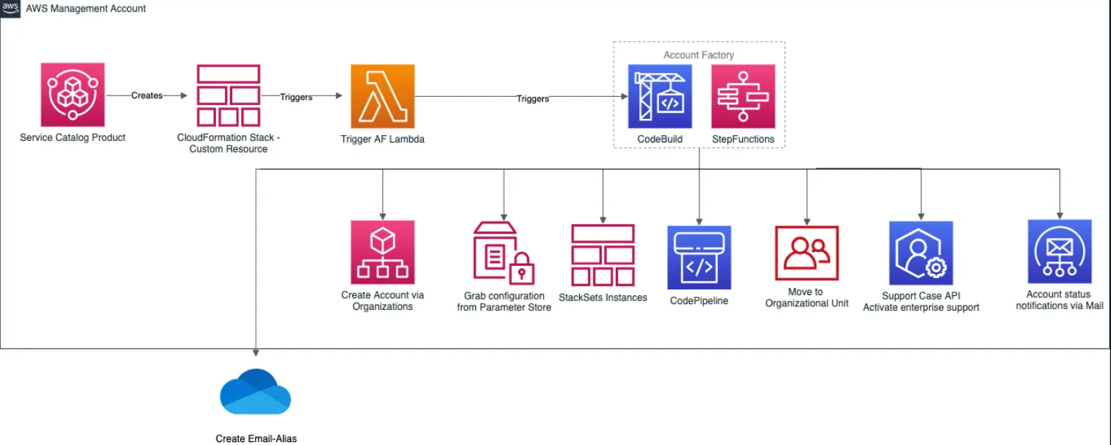
Account Factory

Slide 13
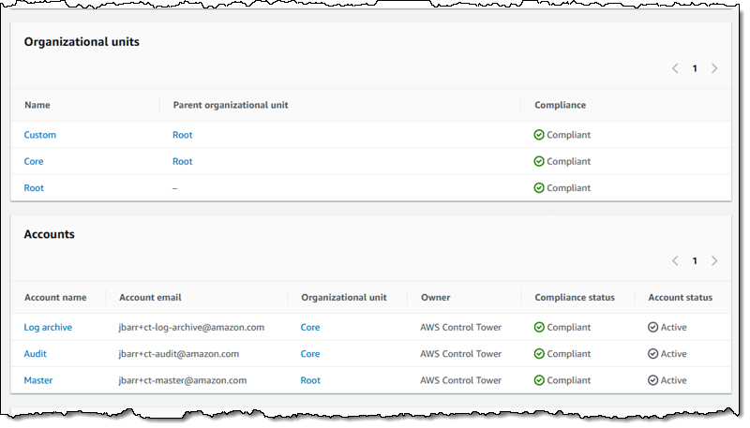
Dashboard

Slide 14
ETC
Integrated Services
Security
Logging and monitoring

